Slide 1
Validation of MTM Method against ACCESS-CM2

Slide 2
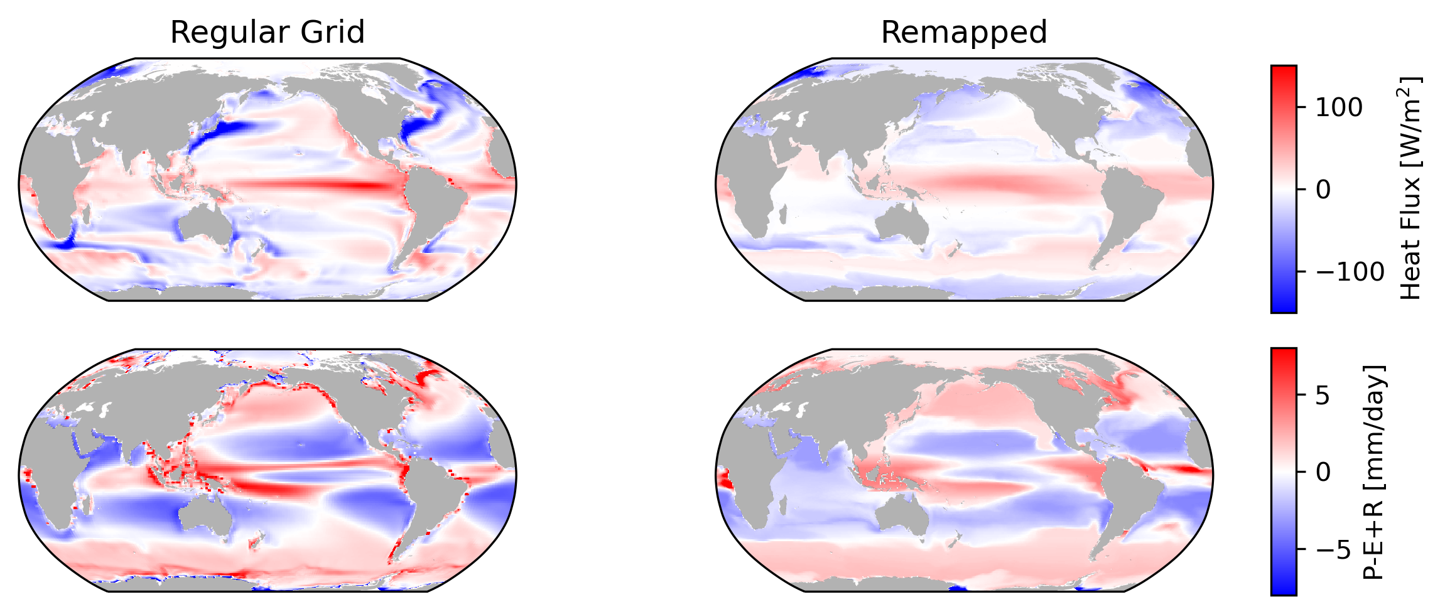
Given a set of Q_priors…

Slide 3
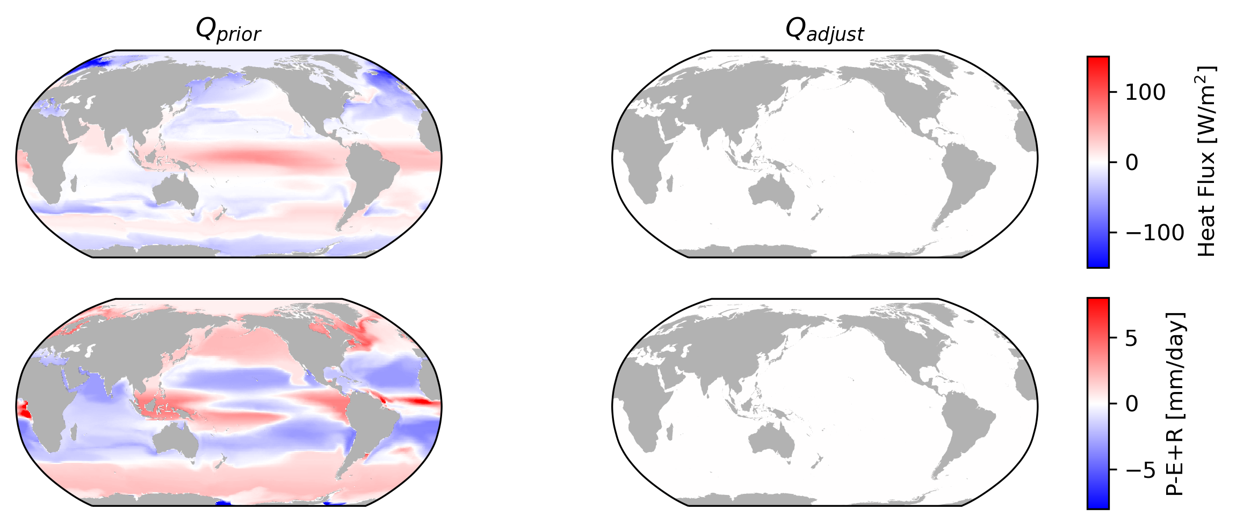
The framework spits out Q_adjust that is zero-ish everywhere

Slide 4
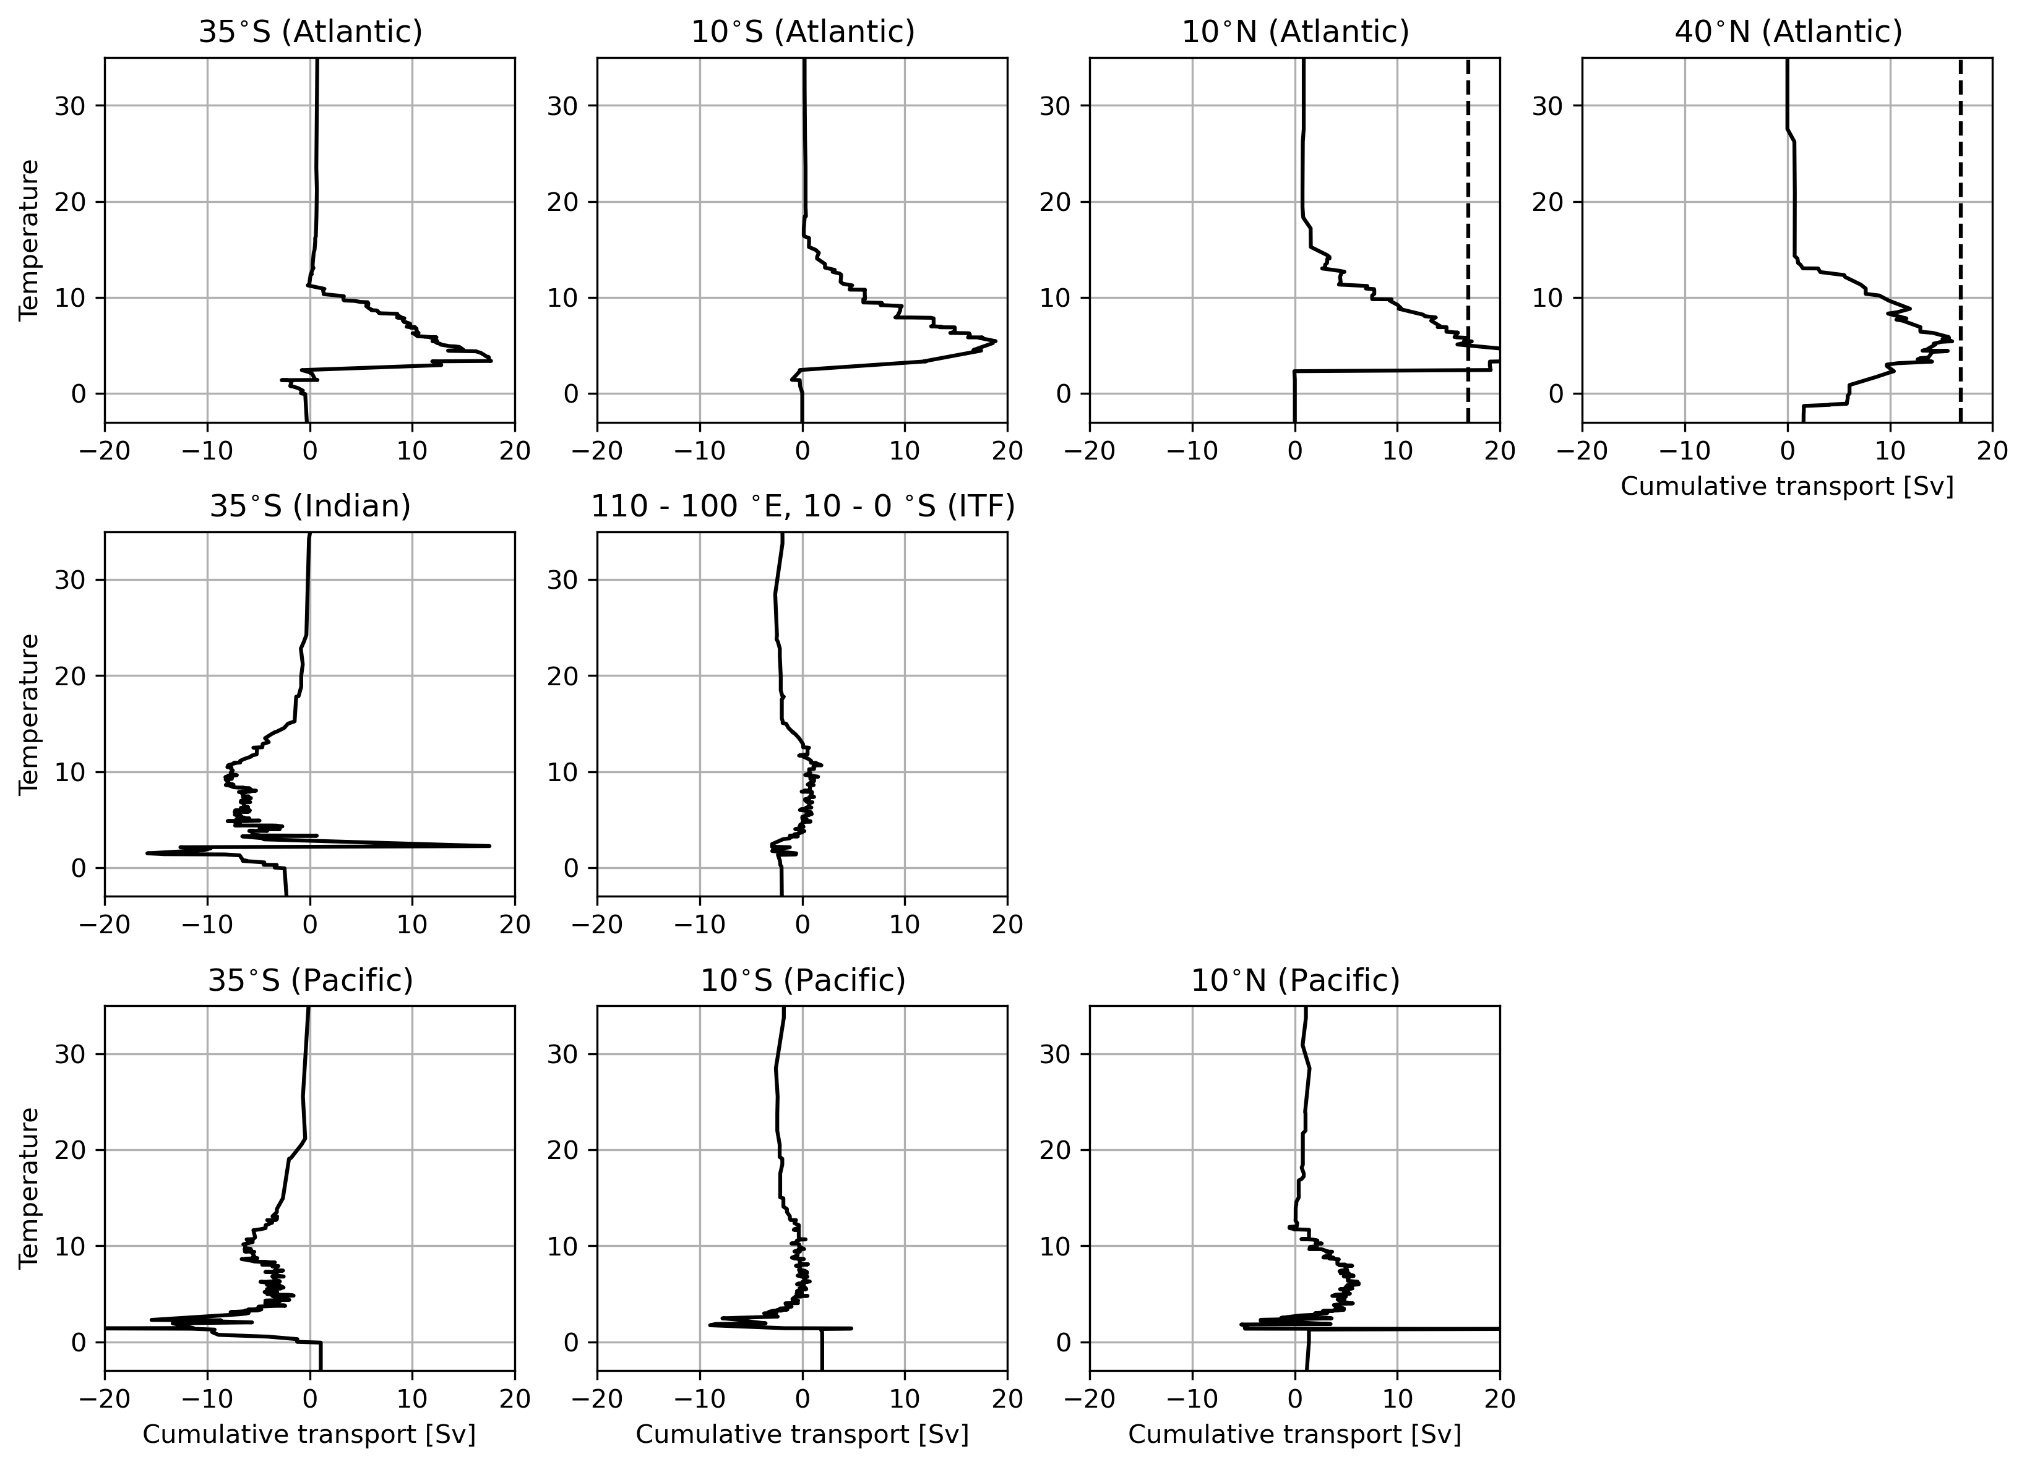
The resulting g_ij matrix should describe the overturning in the model

Slide 5
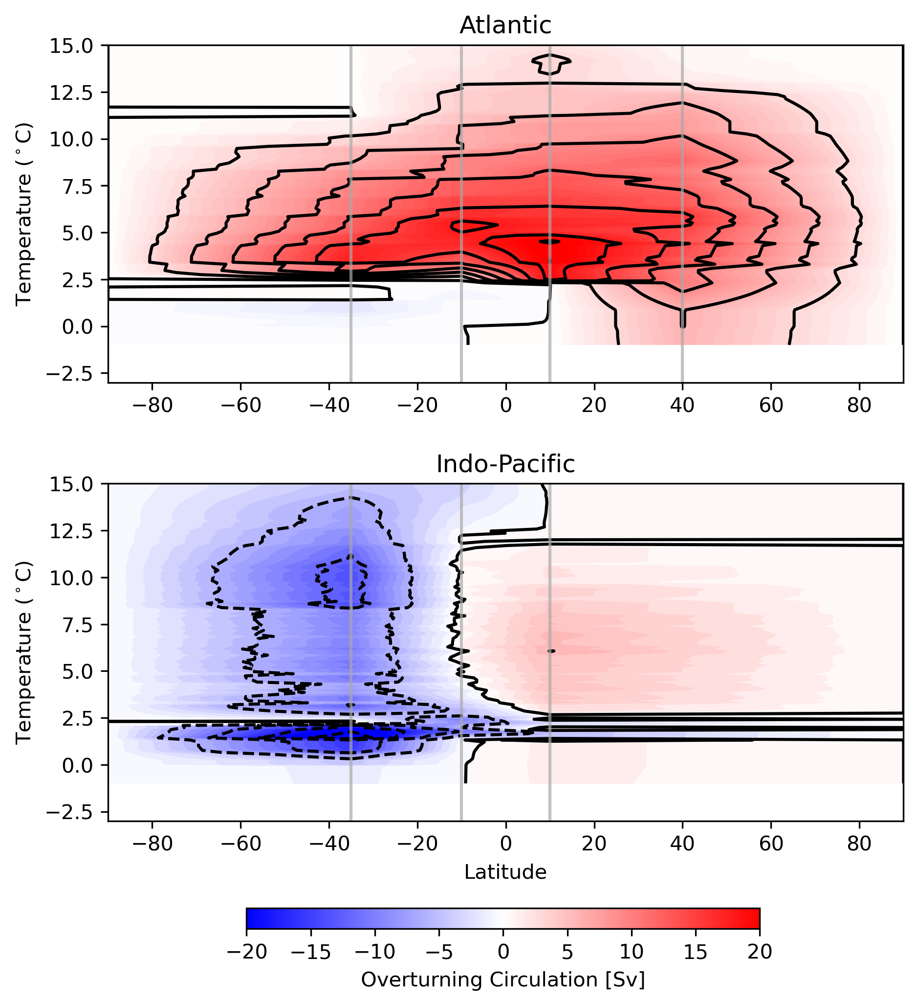
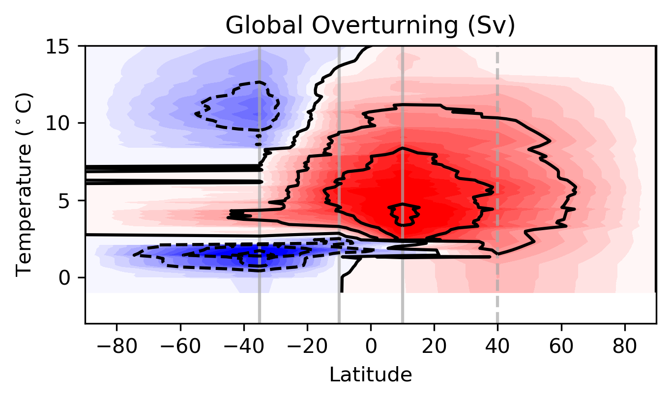
The resulting g_ij matrix should describe the overturning in the model
*yet to be validated with actual ACCESS MOC

Slide 6
Under the hood
Q_prior | Weights | Connectivity | Scaling Factor
Q_actual | np.sqrt(areanorming/A_2); A2[A2==0] = 10**-14 | Adjacent Basins, All T/S classes allowed to mix | beta/alpha

Slide 7
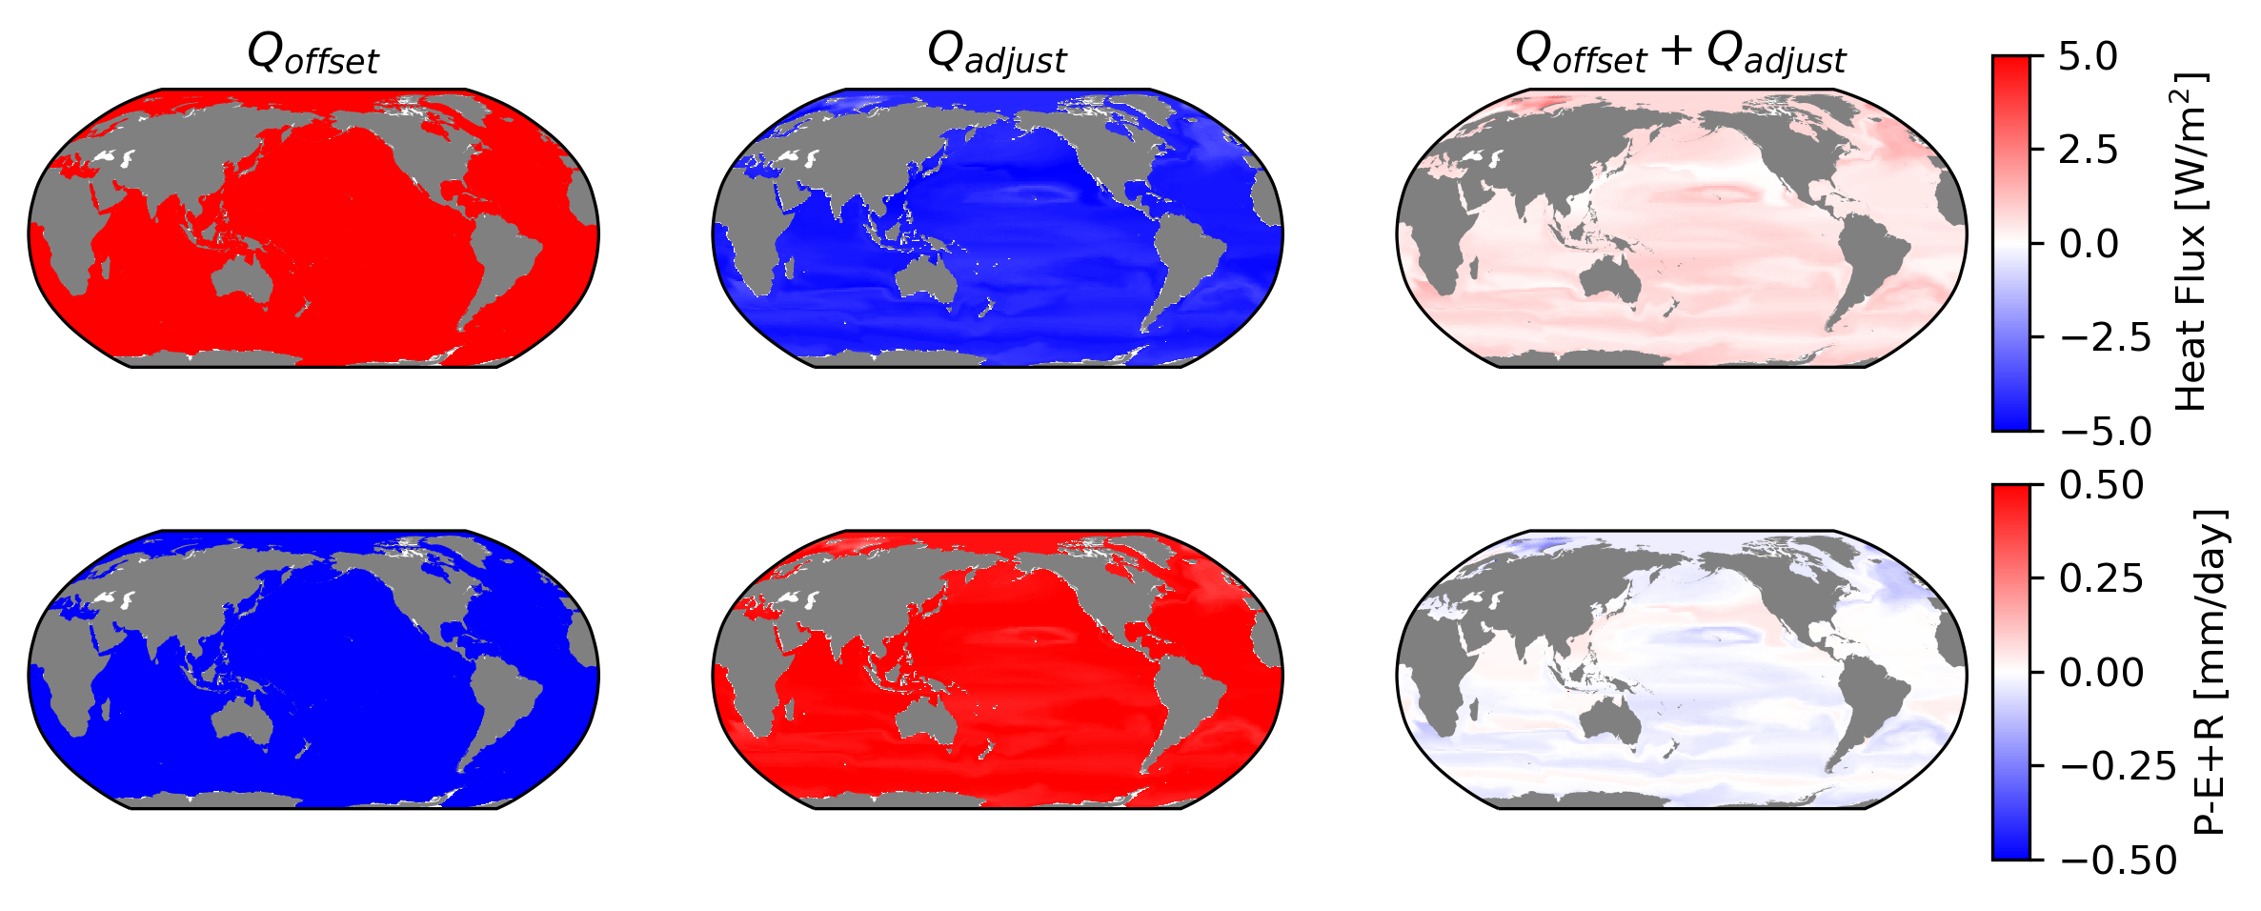
If the Q_actual is nudged by some constant heat/FW flux…

Slide 8
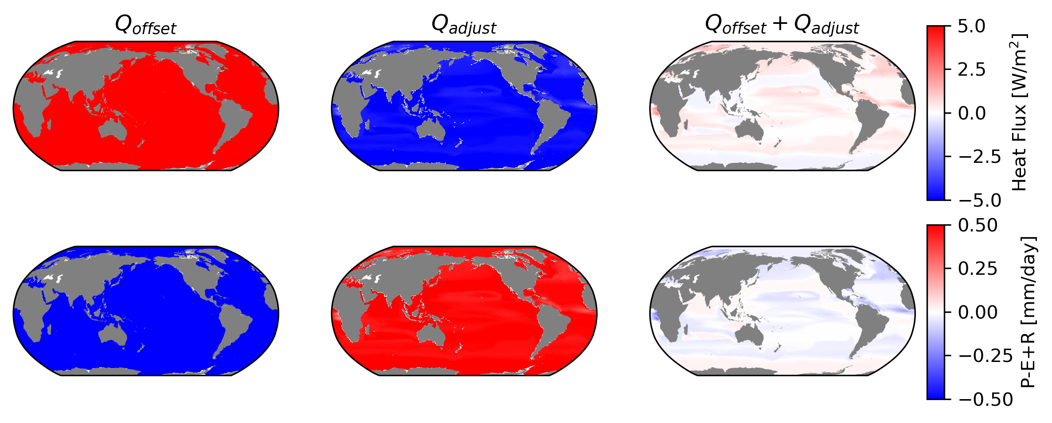
A[A==0] = 10^-14

Slide 9
A2@x==b2

Slide 10
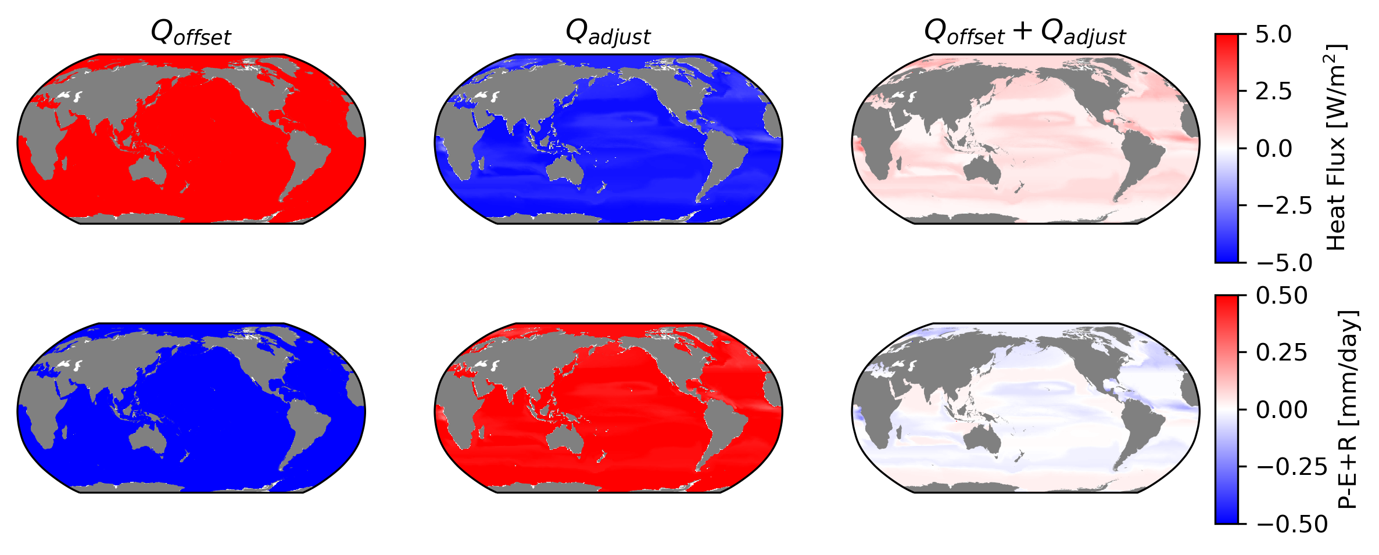
A[A==0] = A.min()

Slide 11
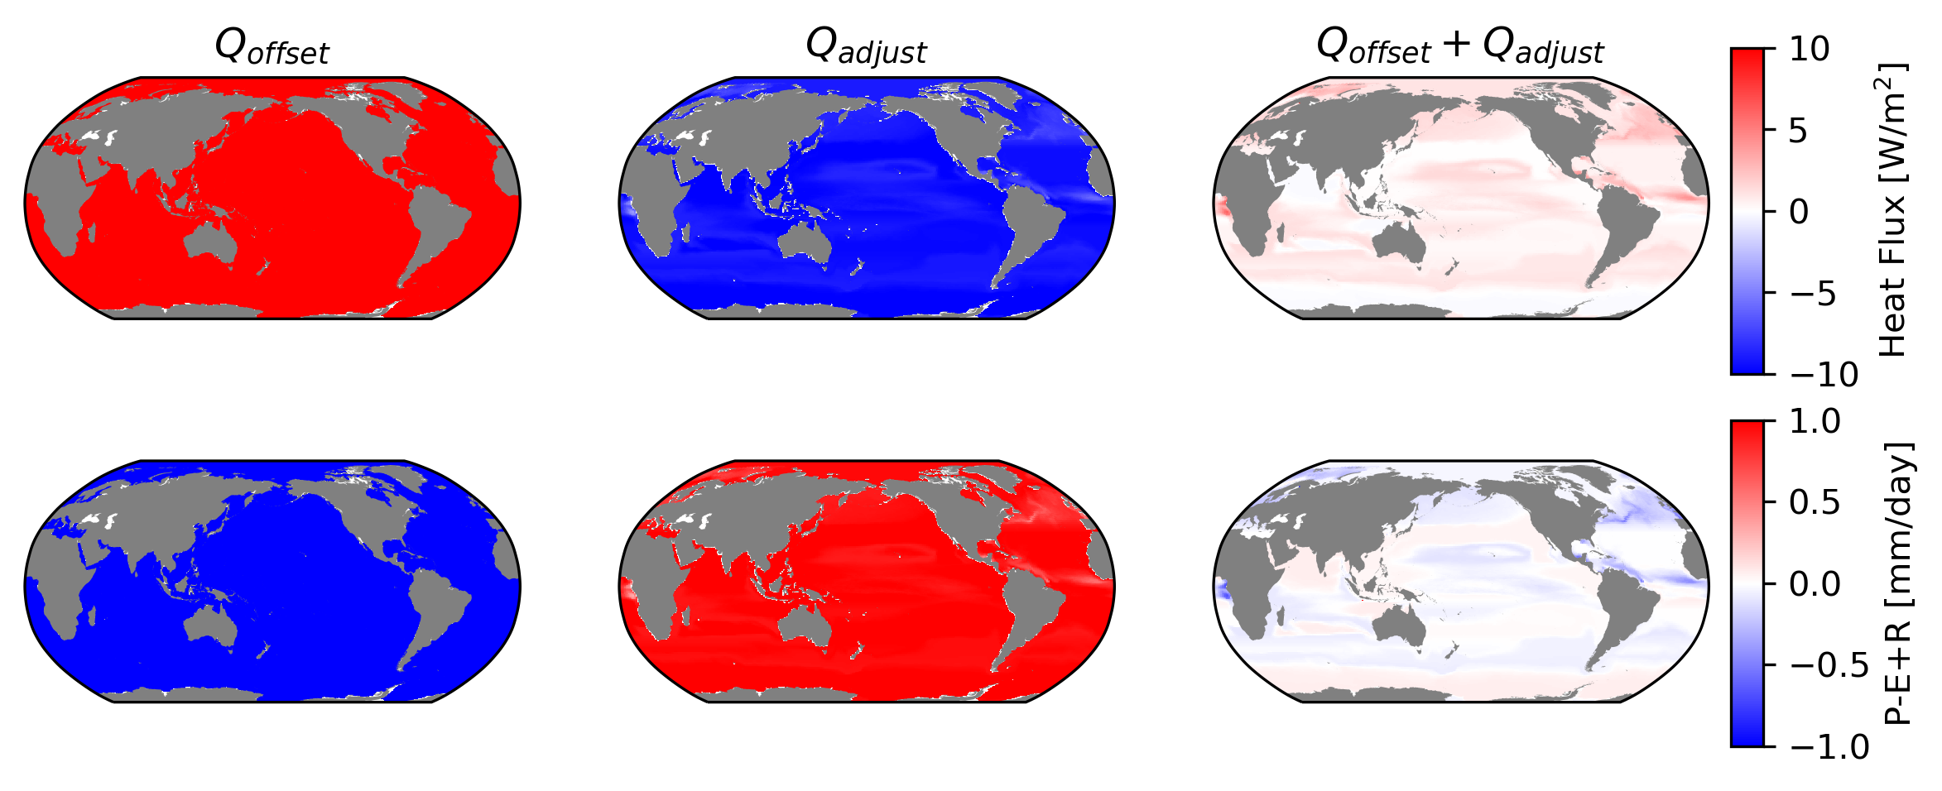
… the resulting adjustment gets us close back to Q_actual (but not quite)

Slide 12
Under the hood
Q_prior | Weights | Connectivity | Scaling Factor
Q_actual +5W/m2 -0.5mm/day | np.sqrt(areanorming/A_2); A2[A2==0] = 10**-14 | Adjacent Basins, All T/S classes allowed to mix | beta/alpha

Slide 13
Validation
Given a closed heat/FW budget and applying the actual heat/FW fluxes, the model closes. ✅
The resulting transports are realistic ✅ (needs further validation)
If we provide a Q_prior that’s been ‘nudged’ away from the actual heat/FW fluxes, the model reverts to the actual fluxes. ✅-ish

Slide 14
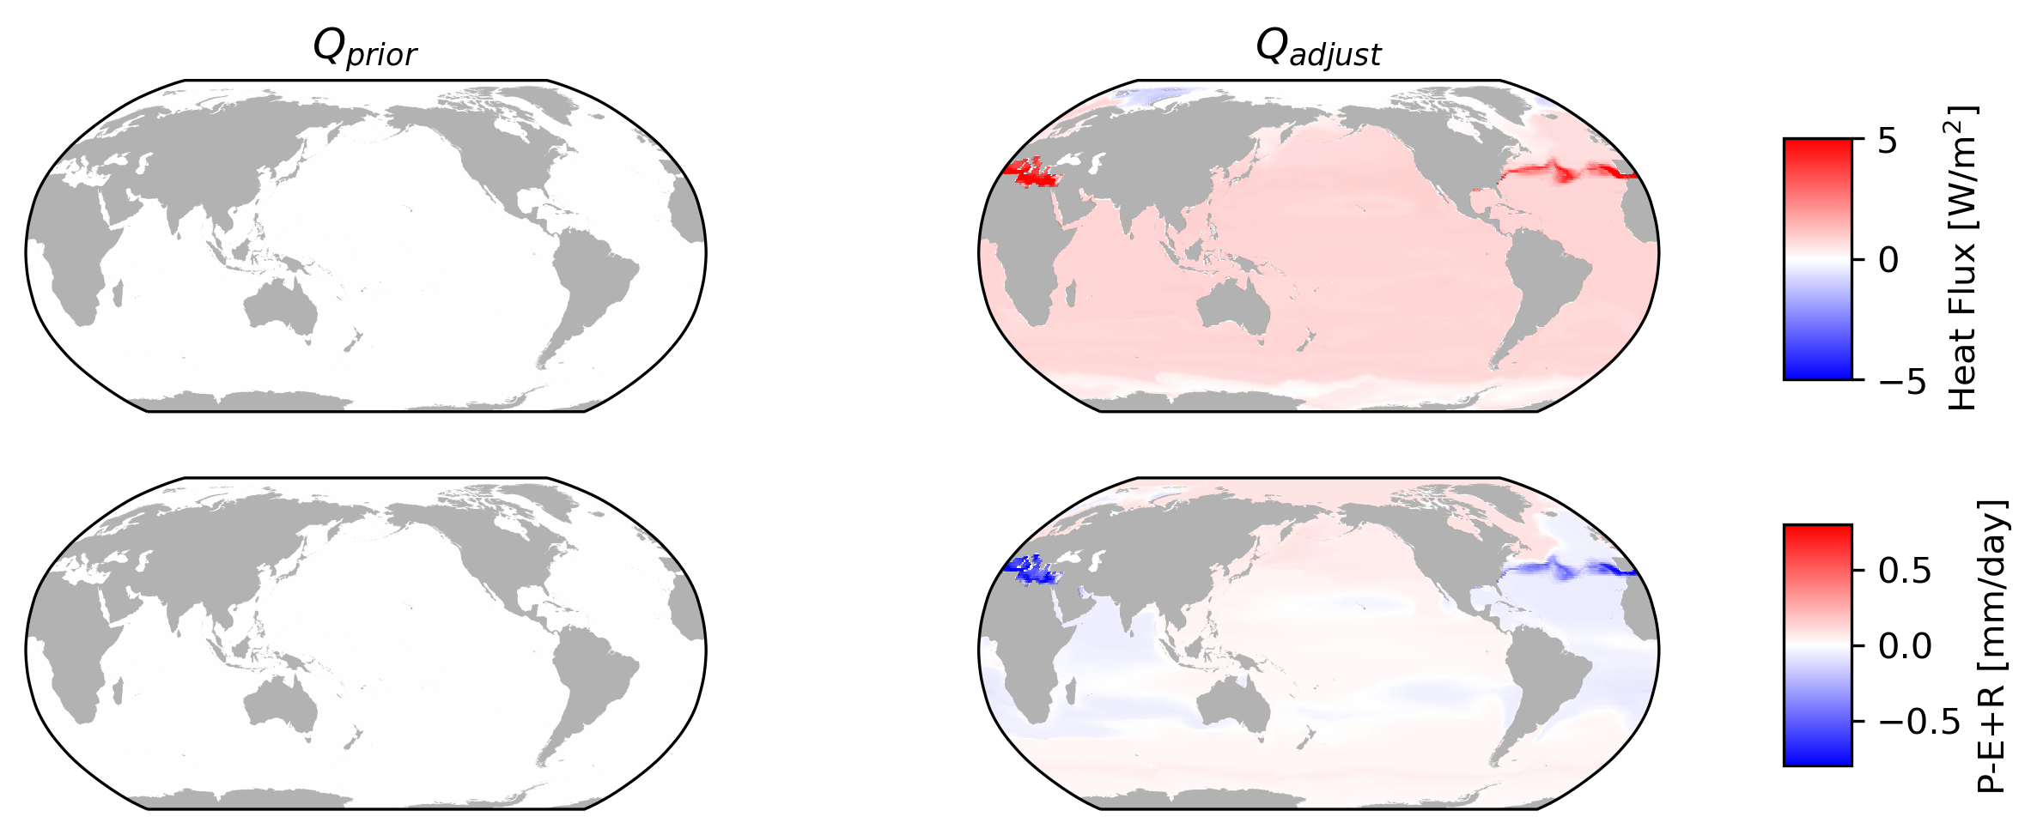
When Q_prior=0, we get an ‘excess heat/FW flux’ estimate (n=7)

Slide 15
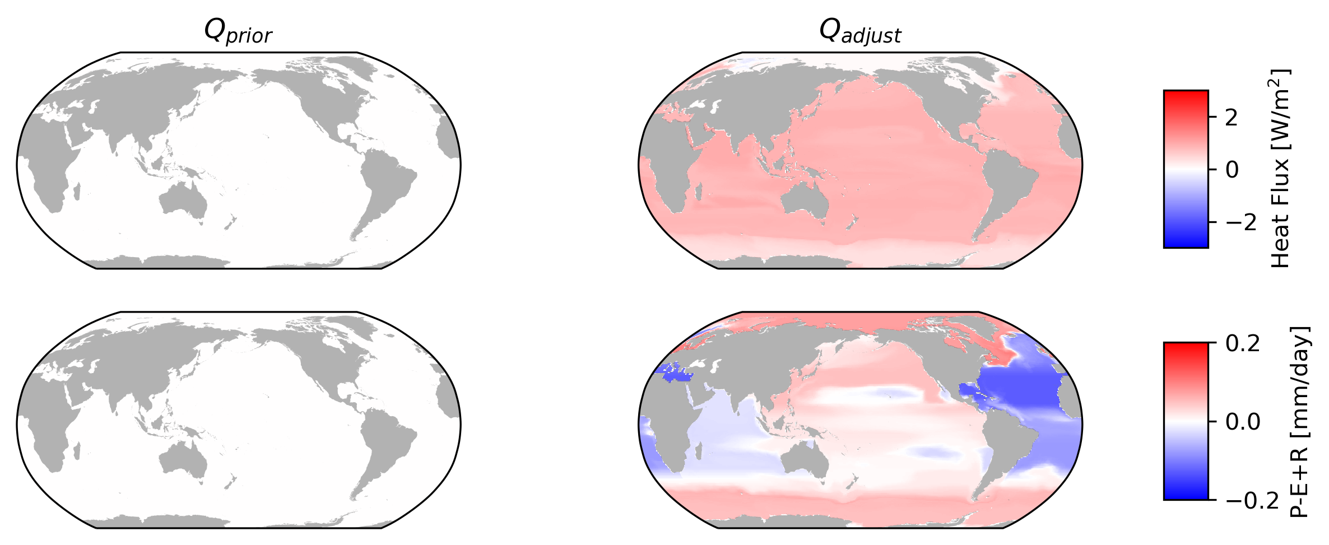
When Q_prior=0, we get an ‘excess heat/FW flux’ estimate (n=4)

Slide 16
Under the hood
Q_prior | Weights | Connectivity | Scaling Factor
0 | np.sqrt(areanorming/A_2); A2[A2==0] = 10^4 (n=7) OR 10^2.1 (n=4) | Adjacent Basins, All T/S classes allowed to mix | beta/alpha

